Slide 1

Weather Prediction App using Machine Learning
Developed By:-
Darshpreet Singh
Jaskaran Singh
Abhayjit Singh

Slide 2

Individual Contribution:
DARSHPREET SINGH
PREPROCESSING OF DATA AND COMPARISON BETWEEN ITS DIFFERENT TOPICS
JASKARAN SINGH
COMPARISON BETWEEN DIFFERENT MODELS OF PREDICTING ACCURACY
ABHAYJIT SINGH
PREPARATION OF GRAPHIC USER INTERFACE (GUI)

Slide 3
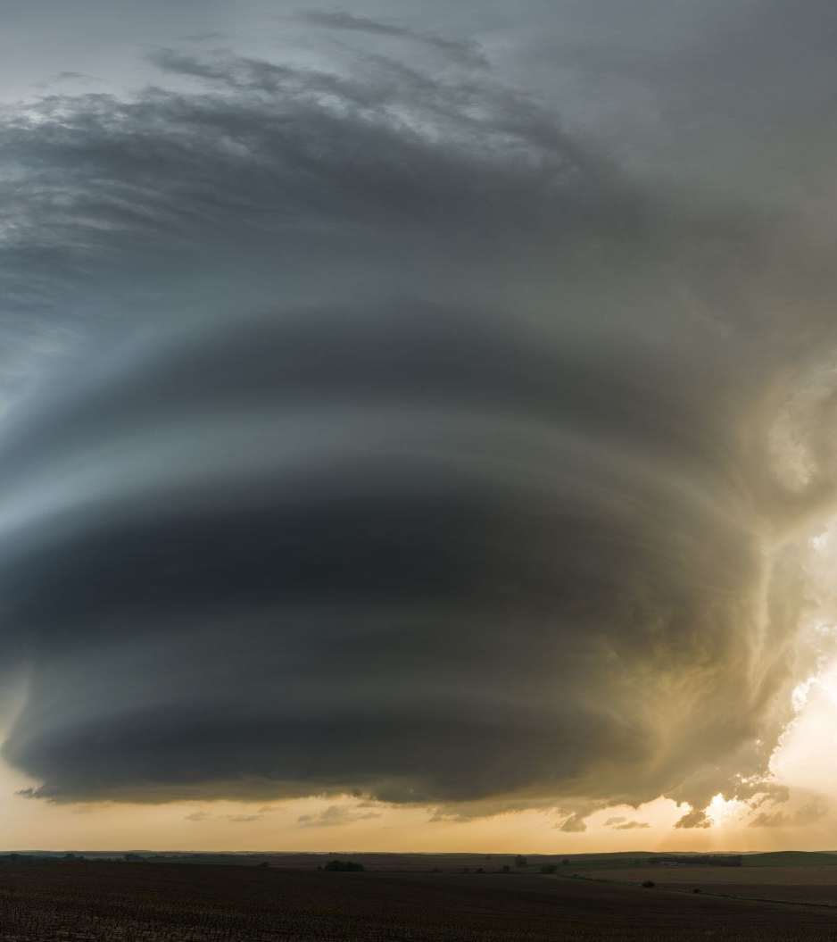
Objectives:
Analyze Weather Data (Data is taken from Kaggle and contains the weather conditions in Seattle)
Predict the weather when inputs such as Precipitation, Maximum and Minimum Temperature and Wind Speed are provided.

Slide 4

Software Used:
Language Used: Python 3.10
IDE used:
Google Collab
Spyder (5.10)
VS Code (1.81)
GUI Language: Streamlit (1.25.0)
Hardware Used:
Windows 7, 10 & 11

Slide 5
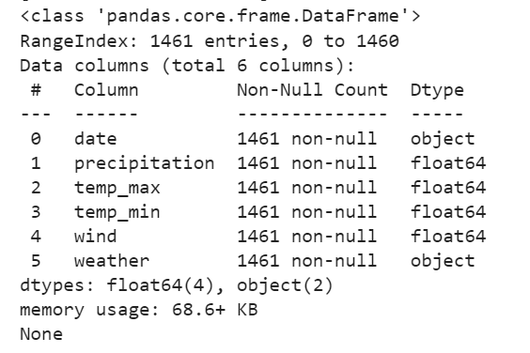
Data Pre-Processing
Printing the General Information about the Dataset

Slide 6
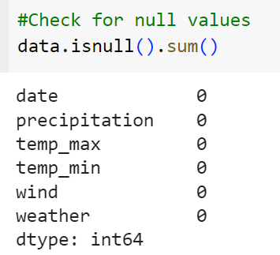
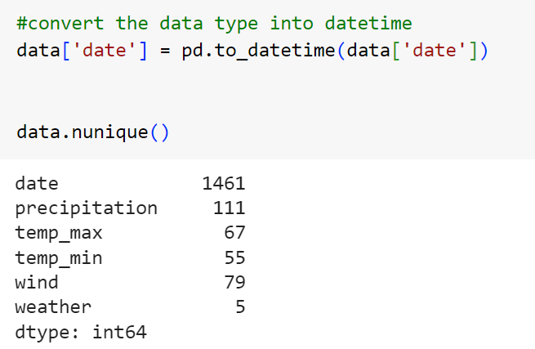
Checking for the null values in the dataset using the null command.
Convert date using datetime command to check for the distinct values.
The nunique () function is used to count distinct observations over requested axis and return series with number of distinct observations.

Slide 7
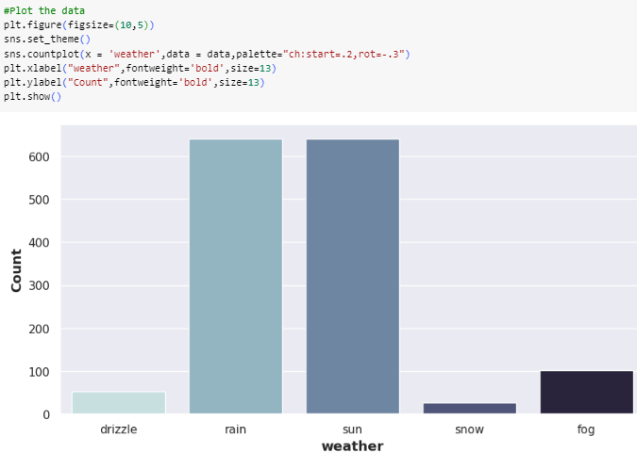
Graphical Correlations
Graph between the number of days and weather conditions

Slide 8
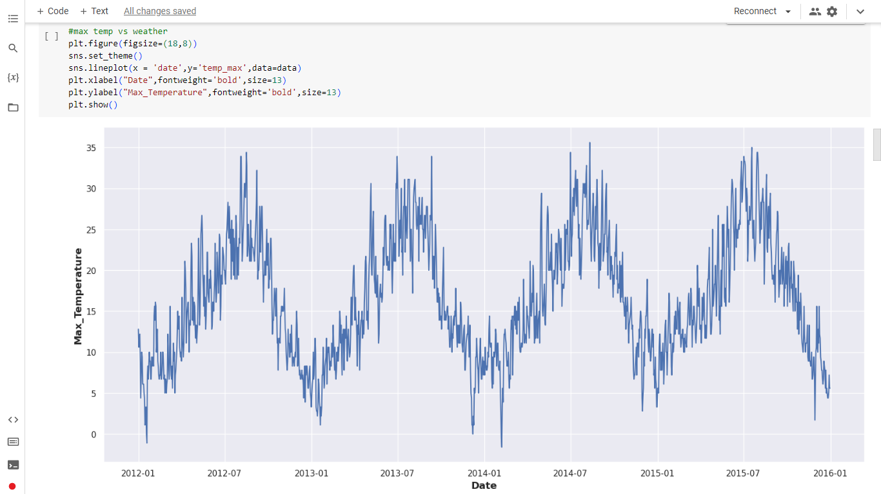
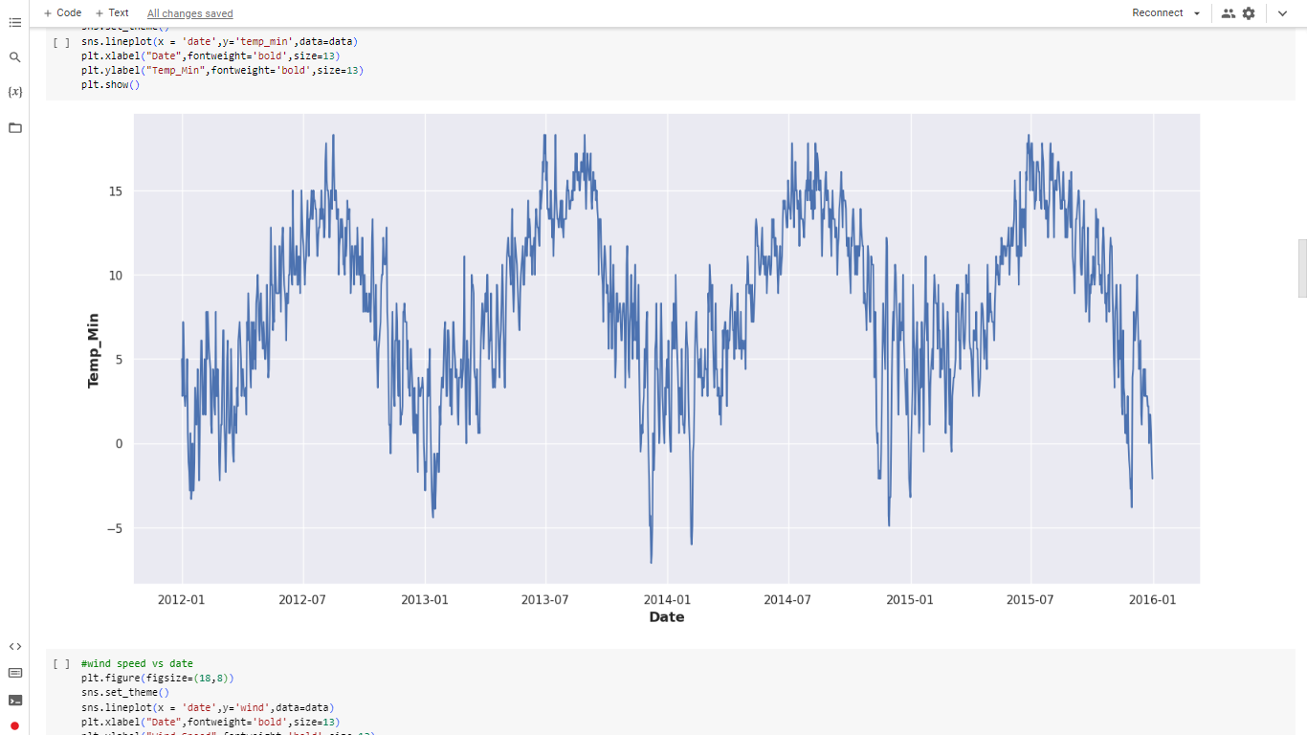
Graph between Maximum Temperature and Date
Graph between Minimum Temperature and Date

Slide 9
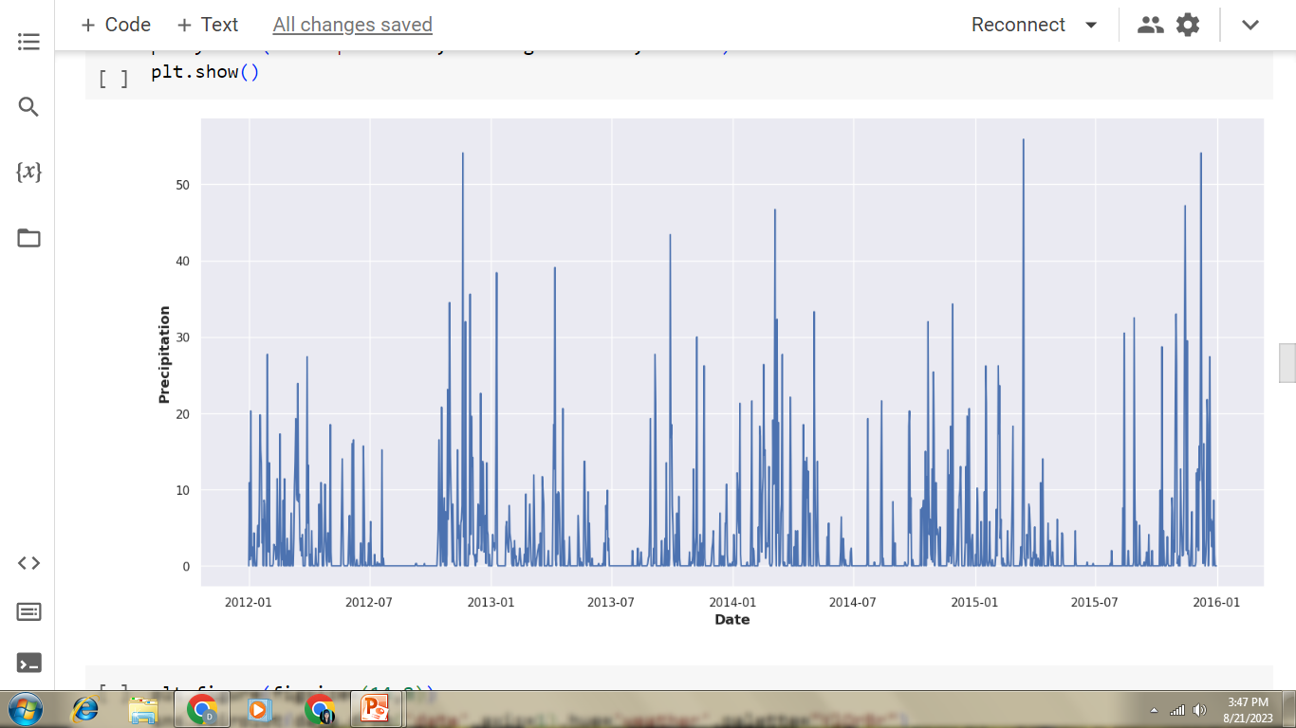
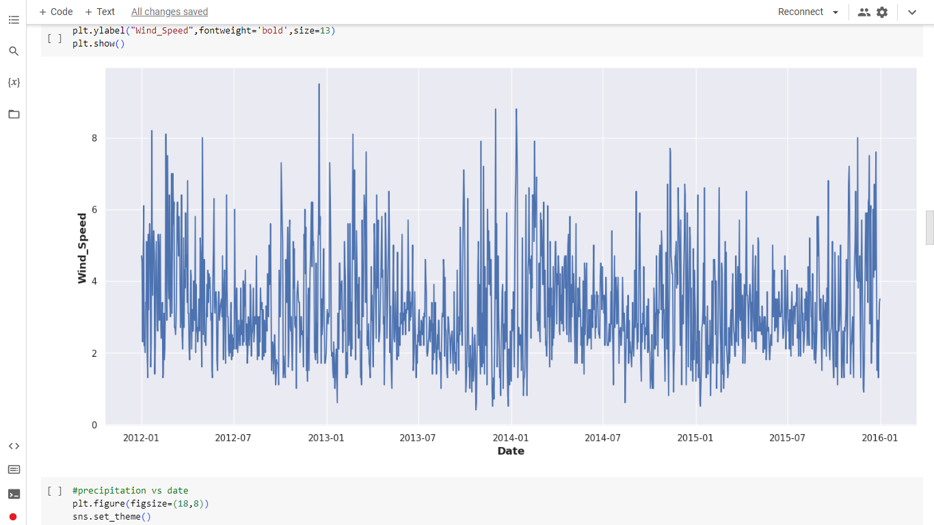
Graph between Precipitation and Date
Graph between Wind Speed and Date

Slide 10
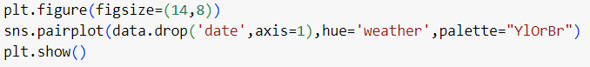
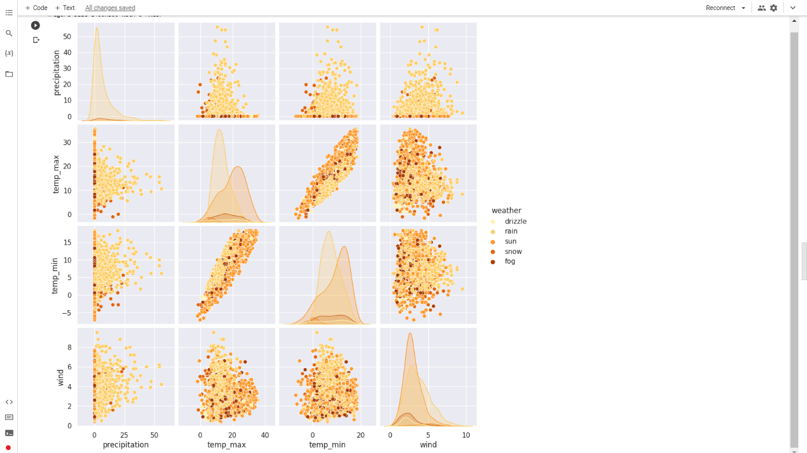
Pair Plot
Here, we are dropping date and then making a pair plot, which helps in making a comparison in data having both categorical and numerical values

Slide 11
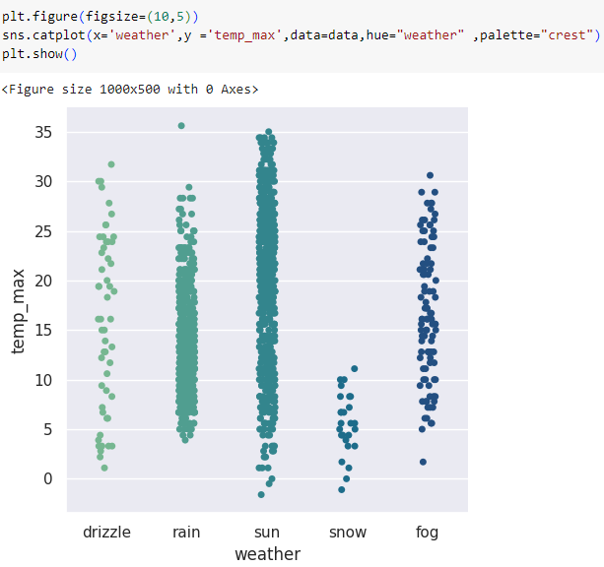
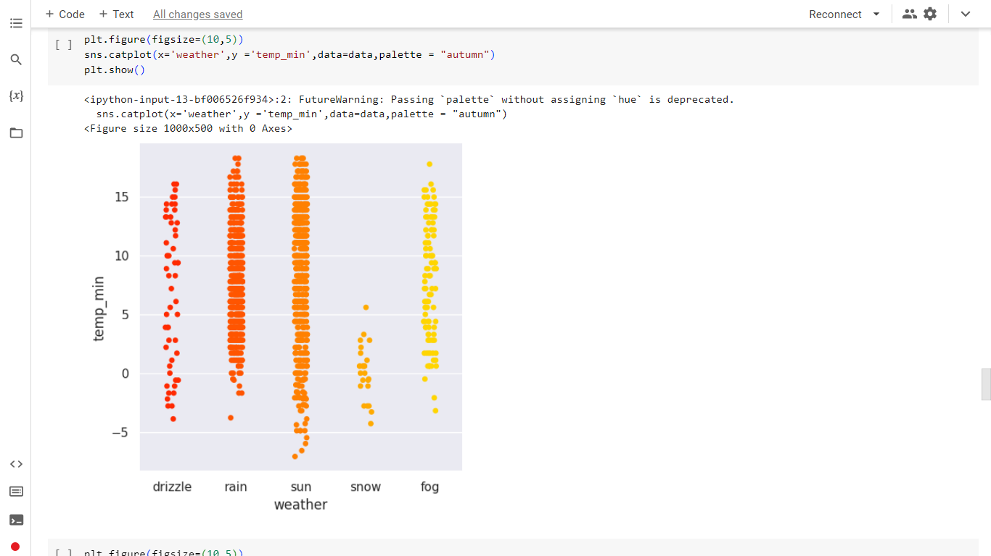
Catplot between maximum temperature and different weather days
Catplot between minimum temperature and different weather days

Slide 12
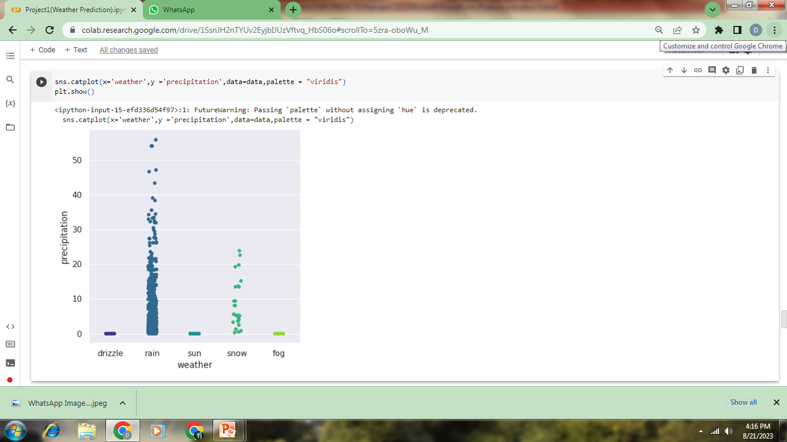
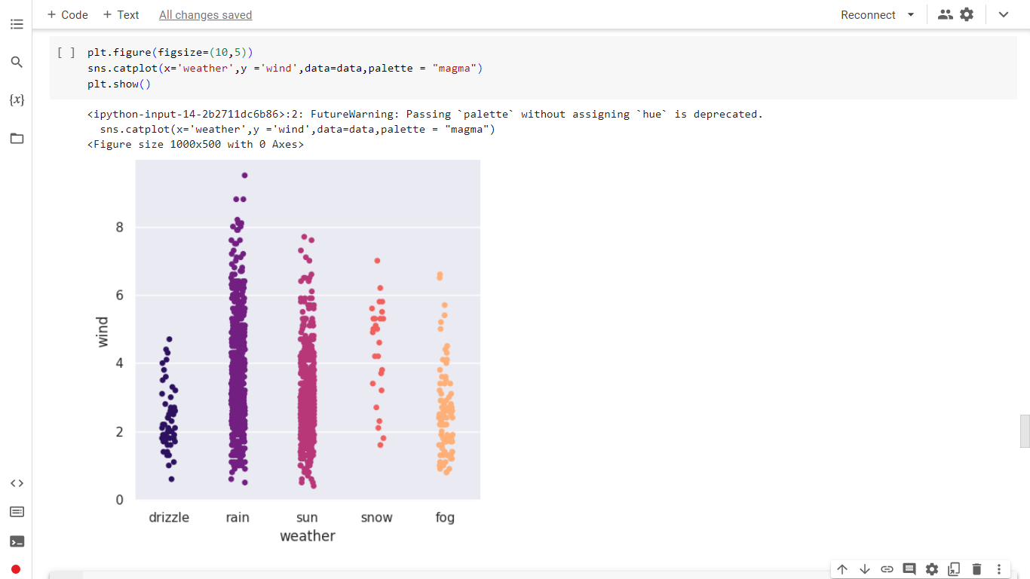
Catplot between Wind speed and different weather days
Catplot between Precipitation and different weather days

Slide 13

Model Planning
In building our weather forecasting model, we follow a structured approach known as model planning. This involves several crucial steps that guide us from defining the problem to selecting the right tools for accurate predictions. Let's break down these steps to understand how we go from raw weather data to a reliable forecasting model.

Slide 14
Feature Selection
There are 6 features in Dataset i.e., Date, Precipitation, Max Temperature, Min Temperature, Wind speed and Weather condition. Out of which we have dropped Date.
Precipitation, Max Temperature, Min Temperature and Wind speed are used as Features as Independent Variables.
Weather Condition is our Dependent / Target Variables.

Slide 15
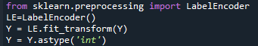
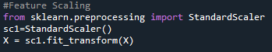
Label Encoder
Our Weather condition is divided into 5 Categories as – Sun, Rain, Snow, Fog, Drizzle.
So, for model training we used Label encoding to convert categorical data to numerical data.
Next, we used Feature Scalar to convert our Independent variables into same scaling

Slide 16

Model Selection
For Model selection as our data is categorical we used classification algorithms for model training. We have used 5 models such as:
Random Forest Classifier
Support Vector Machine (Classifier)
K-Nearest Neighbors
Naive Bayes (GaussianNB)
Extreme Gradient Boosting

Slide 17
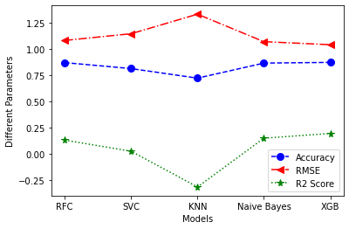
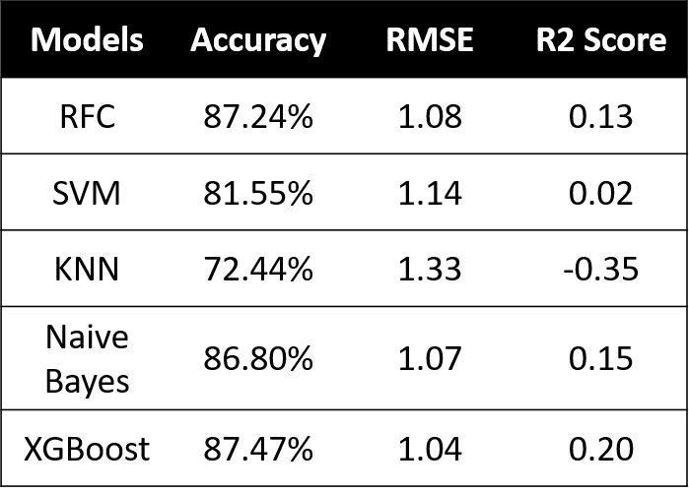
Selected Model:- As seen from the table and Graph we have taken XGBoost as models for predicting values for our data.
Data Splitting:- We have used 70-30 method to split our train and test data.

Slide 18
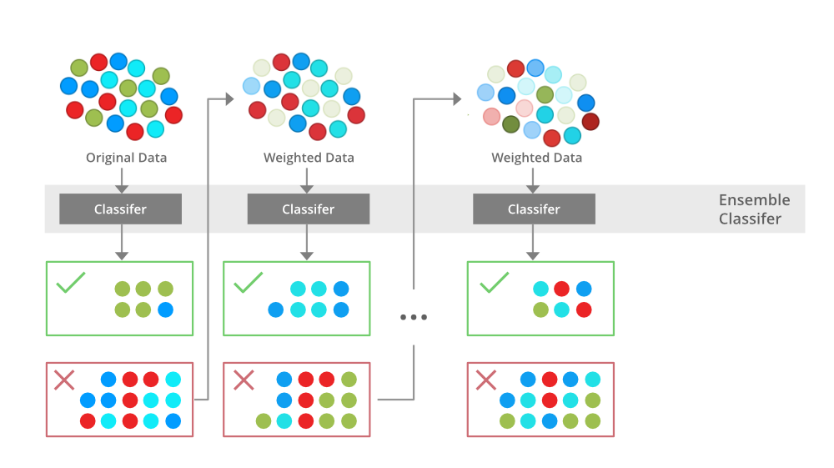
Model Building
XGBoost:-
XGBoost (eXtreme Gradient Boosting) is a powerful machine learning algorithm known for its high performance in classification and regression tasks. It combines multiple weak learners (usually decision trees) to create a strong predictive model through gradient boosting. XGBoost employs regularization, handles missing values, and offers insights into feature importance. It's efficient, handles large datasets, and has interfaces for Python and R. Its exceptional accuracy and versatility make it a popular choice in competitions and real-world applications.

Slide 19
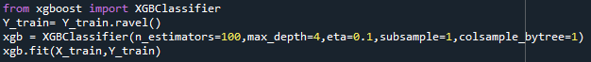
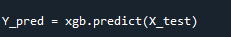
Model Training and Predicting the Values

Slide 20
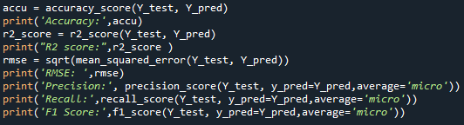
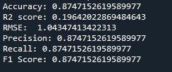
Parameters for Model Performance

Slide 21
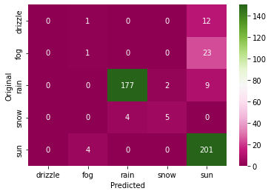
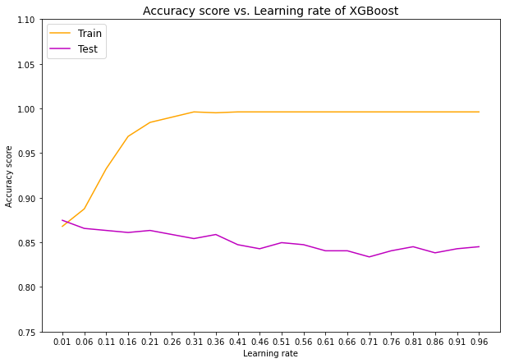
Confusion Matrix
Learning Curve of Model

Slide 22
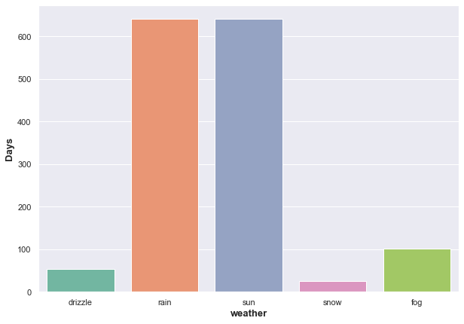
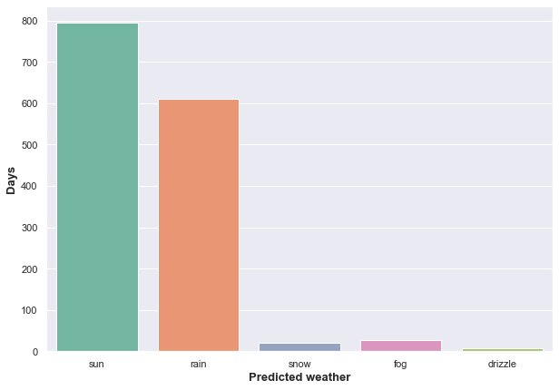
Actual v/s Predicted values

Slide 23
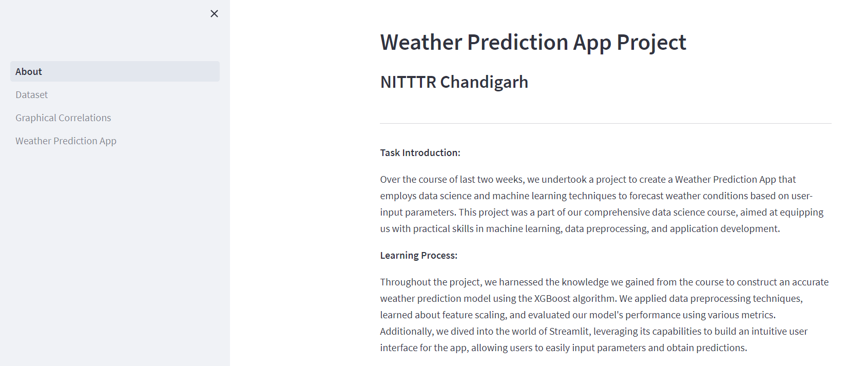
GUI (Graphical User Interface)
A Graphical User Interface (GUI) is a visual interface that lets users interact with software through buttons, menus, and visual elements. It simplifies complex tasks by providing an intuitive, user-friendly experience. GUIs are essential as they enhance usability, reduce the learning curve, and enable efficient communication between users and software. In the Weather Prediction App, the GUI empowers users to input parameters and obtain predictions effortlessly, making technology accessible to all.

Slide 24

Streamlit for GUI
Streamlit is an open-source Python library that simplifies the process of creating web applications for data science and machine learning projects. It allows developers to transform data scripts into shareable web apps with minimal effort.

Slide 25
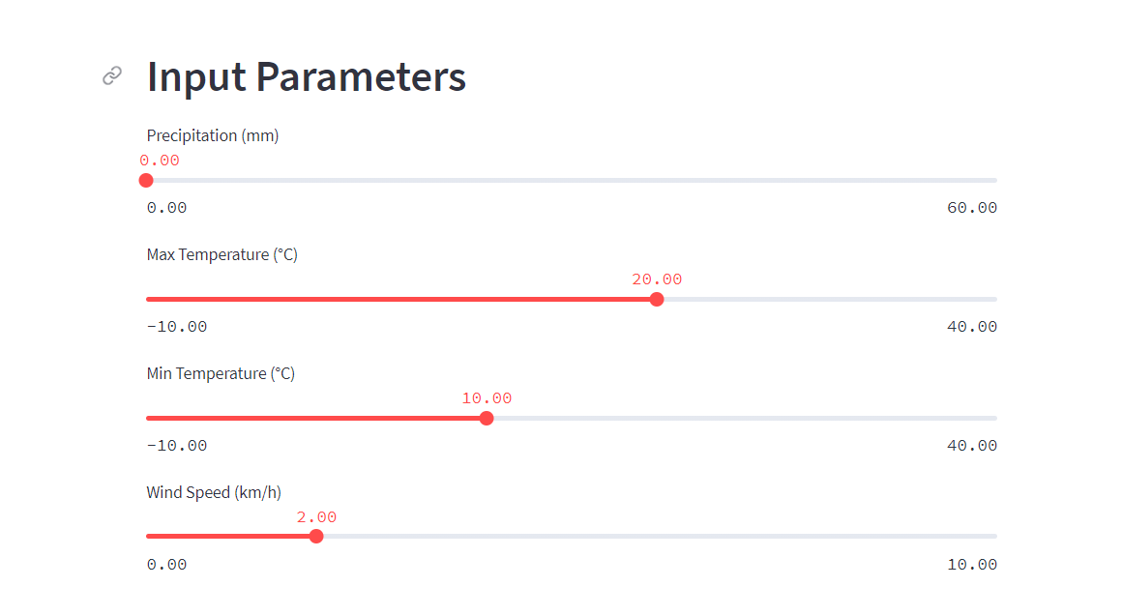
Use of GUI
GUI in the Weather Prediction App serves as the gateway for users to interact with the underlying predictive model. Through sliders and visual elements, users can input parameters such as precipitation, temperature, and wind speed.

Slide 26
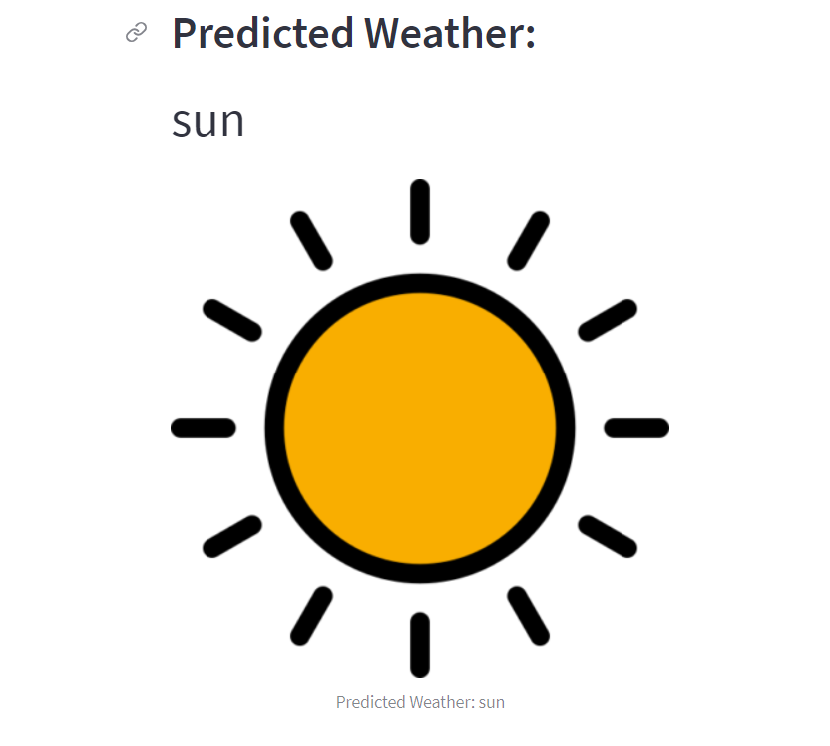
Working of GUI
The GUI processes the inputs, sends them to the prediction model, and presents the forecasted weather condition.

Slide 27

Future Scope
Aim
Aim to enhance user experience with additional features like weather maps and real-time updates.
Encourage
Encourage user feedback and contributions for continuous improvement.
Explore
Explore partnerships with weather data providers for real-time data integration.
Extend
Extend the app's reach to serve users worldwide.

Slide 28

Thank You!

